Slide 1
Body Sculpting
Hands-On Training

Slide 2
RELEASE OF LIABILITY WAIVER
NON-COMPETE AGREEMENT
In exchange for participation in the activity of Body Sculpting Training organized by YOUR COMPANY NAME & ADDRESS and TRAINEE I agree for myself to the following:
AGREEMENT TO FOLLOW DIRECTIONS. I agree to observe and obey all rules and warnings, and further agree to follow any oral instructions or directions given by Body Contouring & More during the training.
ASSUMPTION OF THE RISKS AND RELEASE. I recognize that there are certain inherent risks associated with the body sculpting activities and I assume full responsibility for personal injury to myself, and further release and discharge Body Contouring & More for injury, loss or damage arising out of my use of machinery. I also acknowledge that BCM is not responsible for my success or future in body sculpting
INDEMNIFICATION. I agree to indemnify and defend Body Contouring & More against all claims, causes of action, damages, judgments, costs or expenses, including attorney fees and other litigation costs, which may in any way arise from my use of machinery.
FEES. I understand and acknowledge that deposits/payments for the above training and/or consultation are non- refundable.
NON-COMPETE. I understand that Body Contouring & More will be disclosed or may disclose information including, ideas, inventions and other technical, business, financial and product development plans, and information, during the training/business class. I understand that this is "Proprietary and Confidential Information". I agree to hold BCM Proprietary Information in confidence and to take all necessary precautions to protect such Proprietary Information. This I understand that this training is NOT a train the trainer session and does not certify me to be able to train or certify others. I agree not to use, steal any information that is shared, provided to me from Body Contouring & More and understand legal actions can be taken in the event I disclose or use any of the consent provided to me. Agreement shall be governed by the laws of the State of California and may be enforced in any court in California.
I HAVE READ THIS DOCUMENT AND UNDERSTAND IT. I VOLUNTARILY SURRENDER CERTAIN LEGAL RIGHTS.

Slide 3
Introduction
YOUR BIO

Slide 4
Agenda
Overview
Certification
Accreditation
Our Client
Radio Frequency
Ultrasonic Cavitation
Vacuum Therapy
Vacuum BBL
Wood Therapy
Laser Panels
Pre & Post
Side Effects
Q&A

Slide 5
Overview
During this training we will focus on technique, product knowledge, cleanliness and safety. We will review what was covered in your online certification. We will have a live model to demo the treatments on. We will cover how to properly measure and take pictures of your clients.
It’s important to understand that Body Sculpting Treatments are not a form of weight loss, rather a way to remove unwanted areas of fat from your body when exercise and diet aren't helping you achieve the look you want. Body sculpting can treat many areas on your body, including your tummy, back, arms, thighs, face, neck, buttocks, calves and knees.
For best results the client will need 6-12 sessions as often as every 3 days or as often as once a week. After the initial treatments are completed, maintenance treatments should take place monthly or as needed.

Slide 6
Certification Overview
Certification must be completed prior to taking clients and is a separate cost. Please use this link to complete your certification. This course is normally $1500 however with the link below you will get it for $500;
{INSERT YOUR CERTIFICATION LINK AND ANY DISCOUNT CODES HERE}
The online course will give you the science behind the business, along with other resources and the hand on videos. You will need to complete a 20 question test and pass with an 80% or better to obtain your final certification.

Slide 7
Accredited Practitioner
There are multiple ways to take your business to the next level, one of them is becoming an accredited practitioner with the National Med Spa Association. As you know, the body sculpting industry is still under regulated which is not always a good thing for the sculptors who provide best practices. By becoming Accredited, you set yourself apart from individuals in this industry who are under trained and under qualified to be performing these services.
The NMSA is Recognized Nationally as a Governing entity commissioned to enforce Local, State & National Regulations within the Non-Invasive Aesthetic Industry. They are our voice, the NMSA will aggressively lobbies Congress, the Department of Education, and state capitols to protect the interest of Non-invasive Aesthetic Practitioners and Educators.
So how do you become Accredited?
There are 4 mandatory courses that need to be completed prior to becoming an accredited practitioner. Here is the link to complete your course, make sure to use code: KELLH8 when checking out;
Training Access– Aesthetics Accreditation International
Mandatory Courses:
Bloodborne Pathogen
Infections Control
First Aid & CPR
Sterilization & Disinfection
Next complete the following NMSA Enrollment form: National Medspa Association Student Enrollment Form (jotform.com)
Last step is to complete the Application; Memberships – National MSA..

Slide 8
Our Client
Clients must be healthy in nature and 18 years of age or older to be treated. People with cardiac and vascular diseases, diabetes, acute illness, comprised liver function, severe bleeding tendencies, Aids, Cancer, pacemakers, metal in their body and women who are pregnant or breastfeeding should avoid undergoing these procedure!
If your clients have any medical conditions that are questionable they must consult their physician to undergo these treatments.

Slide 9
Radio Frequency
Radio frequency treatments deliver an electrical current via electrodes to the skin, in order to heat the deep and superficial layers. When our skin receives a high frequency electrical current the cells in our bodies interpret this as an energy source and the layers in our skin act like a resistor to the electrical current and depending on their level resistance, will heat up to varying degrees.
The local heating causes an immediate contraction of the collagen fibers and fat cells drain then shrink, while those all important fibroblast are stimulated to produce new collagen and elastic fibers. The effect of this is tighter, smoother, younger looking skin with a visible ‘lift’. Fat cells are reduced and stubborn cellulite looks a lot less noticeable.
While radio frequency skin tightening has a lower instance of side effects than other cosmetic and non-invasive procedures, there are still risks involved. Common side effects that have been reported include mild swelling of the treated skin, redness, sinking of the treated area, and sensitivity.
Radio Frequency is ideal to treat the face, neck, arms, inner and outer thighs, male breasts, pubic mound, buttocks, knees, hips and abdomen.

Slide 10
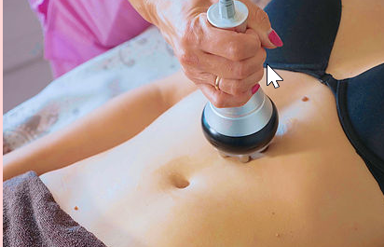
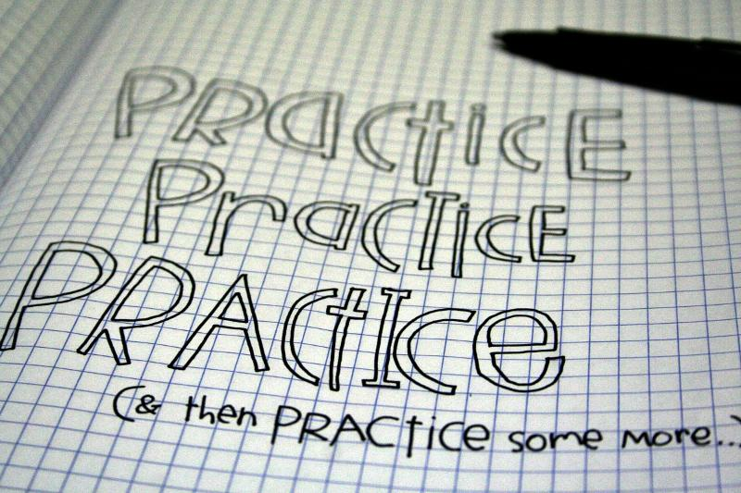
Radio Frequency Demo

Slide 11
Ultrasonic Cavitation
Ultrasonic cavitation is an FDA-approved non surgical fat reduction procedure that uses ultrasound to destroy fat cells in targeted areas—typically the arms, belly, love handles and thighs. Using cutting edge technology it converts fat cells into liquid which can then be naturally drained by the body’s own natural filtration system. The cavitation may cause effective consumption of calories and moisture in fat cells and reduce the size of fat cells making them explode instantly, reducing the amount of fat cells and thereby achieving the effects of removing fat.
Clients may experience a slight ringing or buzzing in the ear during the treatment as the sound waves penetrate the body. This sound is only heard when the Ultrasound Cavitation applicator is used and stops when the applicator is taken of the skin.
Ensure that your client comes to the treatment hydrated and remains hydrated after the treatment avoiding alcohol consumption for at least 72 hours.
When performing Ultrasonic Cavitation treatments, avoid treating the bone area as this can cause long term damage and frailness of the bone.

Slide 12
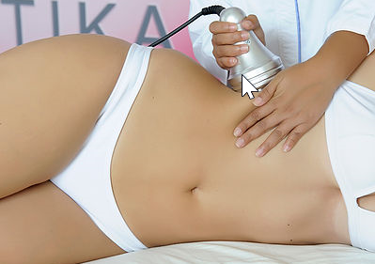
Ultrasonic Cavitation Demo

Slide 13
Vacuum Therapy
Vacuum suction treatment is applied to the surface of the skin tissue causing lift and stimulates muscles, breaks down cellulite and fatty deposits, eliminating toxins, improving lymphatic drainage and taking inches off. Vacuum therapy also helps restore the skin's natural elasticity to smooth the appearance of dimpling in the thighs and buttocks. This therapy is painless, safe and highly effective. Lymph fluid transports metabolic waste and fatty materials via the lymph nodes and lymphatic system. Vacuum suction improves lymphatic and blood circulation. Since the dead skin is reduced there will be great improvement in the skin textures. Fat deposits in the parts of the body will be improved.
The side effects of the Vacuum Therapy are minor. A slight sensitivity that lasts for a few days and mild redness are some of the side effects. This side effects won’t prevent your client from doing their daily duties. The results may vary depending on the number of treatment your client wants.

Slide 14
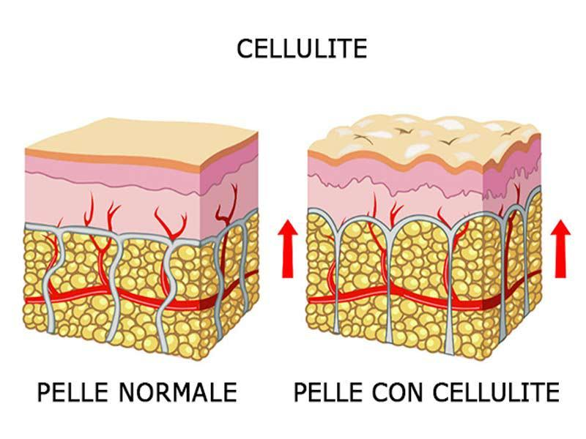
Vacuum Therapy Demo

Slide 15
Vacuum BBL
Vacuum therapy for butts, enlarge and tone your buttocks in weeks. This procedure involves two suction cups being attached to each buttock. You need anywhere from 4 to 12 sessions for a firmer, plumper, perkier, larger, and rounder BUTT! The benefits of butt cupping are great! The procedure promotes blood circulation, clearance of toxins, and removes cellulite and clumpy fatty deposits. It reshapes and contours your butt. One treatment is equal to 1500 squats.
The Brazilian Butt Lift procedure is completely non-surgical, so typically your client can return to normal activities immediately. Some clients experience redness, minor bruising, tingling, numbness or discomfort in the treated area, but this is temporary and will resolve completely. Often times, clients return to work after the session is over.

Slide 16
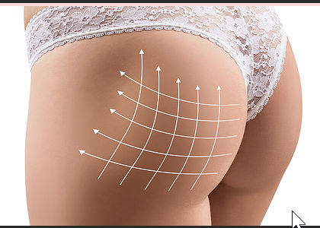
Vacuum BBL Demo

Slide 17
Wood Therapy
Natural, non-invasive ,Activates lymphatic system, Reduces/fights/combats water retention and removes toxins from the body,Speeds up metabolism,Breaks down cellulite,Reduces size (“Muffin tops”, “Love handles”, ”Saddlebags” on thighs etc.),Defines arms and legs, Tones and tightens skin, Firms thighs and buttocks.
Wood Therapy is ideal to treat back and belly fat, thighs, buttocks, waist, thighs, and upper hips.
.

Slide 18
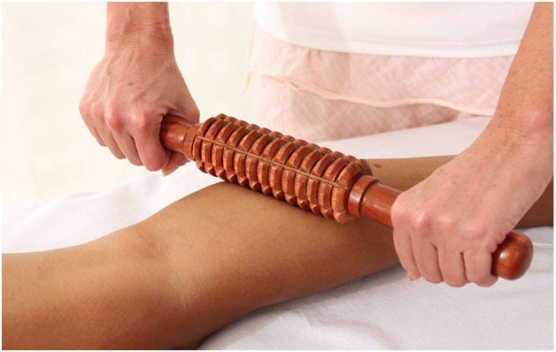
Wood Therapy Demo

Slide 19
Lipo Laser
Laser Lipo procedure uses lasers at various wavelengths to liquefy fat cells. The laser causes the collagen to contract, which tightens the skin. By directly targeting fat cells the Cold Laser Lipo offers a safe and effective spot fat reduction solution that can be applied to multiple problem areas. The most common treatment areas include: Abdomen; Waistline; Thighs; Arms; Under the chin.
Though side effects are not come, your client may experience, skin redness, swelling and soreness.

Slide 20
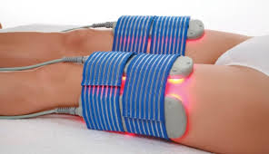
Lipo Laser Demo

Slide 21
Pre & Post
Pre/Post Treatment Instructions:
Avoid eating two hours before and after treatment sessions
Avoid heavy meals on the treatment days
Drink plenty of water to facilitate lymphatic drainage
Limit carbonated drinks, coffee, and tea during treatment period
Avoid fasting or the body will go into “starvation mode” and become more resistant to the release of stored fat
We encourage the client to perform 30-45 minutes of cardio-vascular work-out after treatment in order to create the energy demand that will facilitate metabolism of the fatty acids and glycerol freed from the fat cells
Consider contraindications or other medical issues that may impact the results of this “one off” treatment. Some medical disorders that may reduce first treatment response include thyroid, immune, lymphatic related conditions, pre-menopause, menopause, diabetes, and infection (including viral)

Slide 22
Side Effects
Possible Side Effects:
Diarrhea: when fat is successfully broken down, it must exit the body as stool. You may or may not notice an increase in bowel movements. Typically, diarrhea is mild and lasts no longer than 36 hours.
Increased urination: loss of water from your tissues is normal following the procedure and is a good sign that you are removing fat from your body. Fat enters the blood from the lymphatic system, increasing the “thickness” of the blood (oncotic pressure), and pulling water from tissues to carry the fat to the bowel for removal.
Flu-like symptoms: & Dehydration: this is rare but can occur due to toxins in the fat being removed via the lymphatic system, causing congestion. Congested lymph pathways can lead to aches, pains, water retention, soreness, and flu-like symptoms. This can be resolved by simply drinking water.
Increased Hunger: this is the body’s attempt at returning to normal by re-accumulating fat. Do not increase food consumption! Follow a low carb, high protein, high fiber diet to combat hunger pains.
Redness: there maybe the slight possibility of some transient redness, from the cavitation or radio frequency treatment. This will go away quickly

Slide 23

Q & A

